Slide 1

Seminar activity – who’s in the news!
Pre-seminar:
What firm/organisation has been in the business news this week &why?
During the seminar:
What type of project does the news relate to?
In/after the seminar:
How can I learn from this to enhance my knowledge of SIA and/or for ass’t?

Slide 2
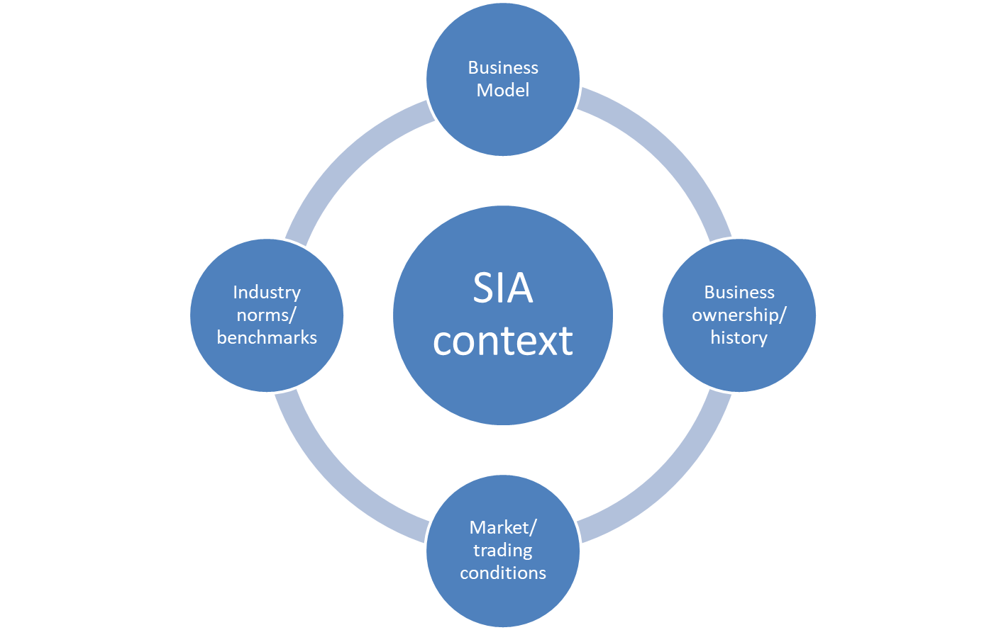
Decision-making context
1. What does the organisation do to create value?
5. How does this shape the decision context?
2. Who owns the enterprise & how has it developed?
4. What are the current industry expectations?
3. What is the business environment/ competitive situation?

